Slide 1
Configuring OSPF
OSPF Neighbors

Slide 2
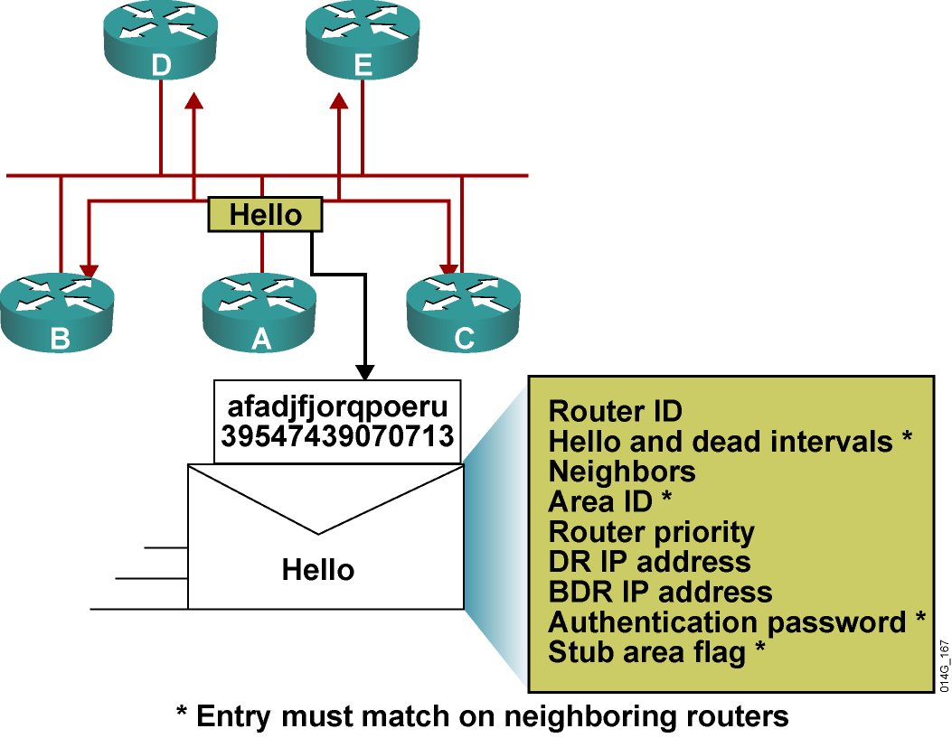
Neighborship: The Hello Packet

Slide 3
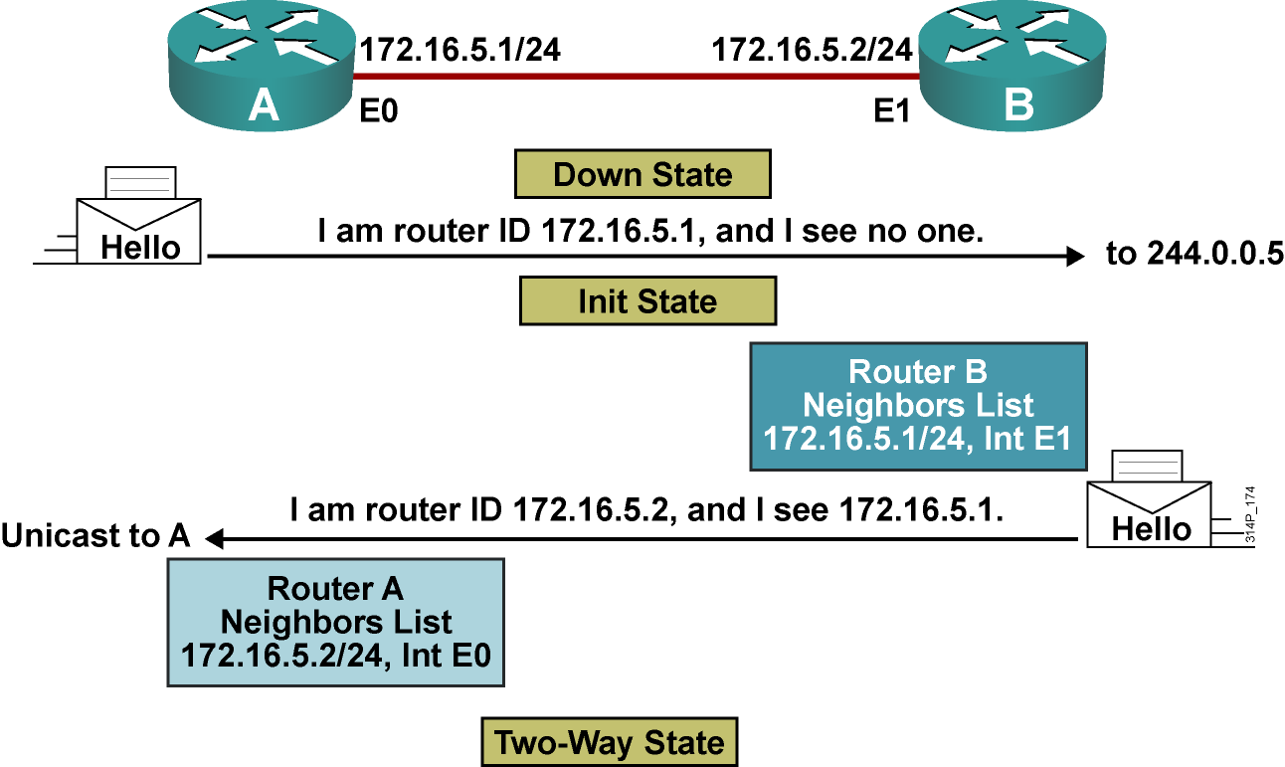
Establishing Bidirectional Communication

Slide 4
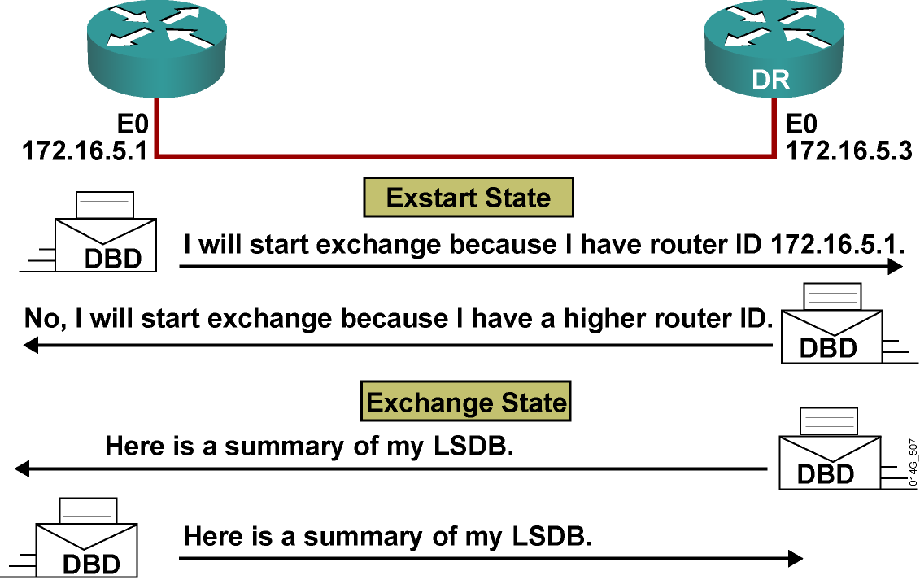
Discovering the Network Routes

Slide 5
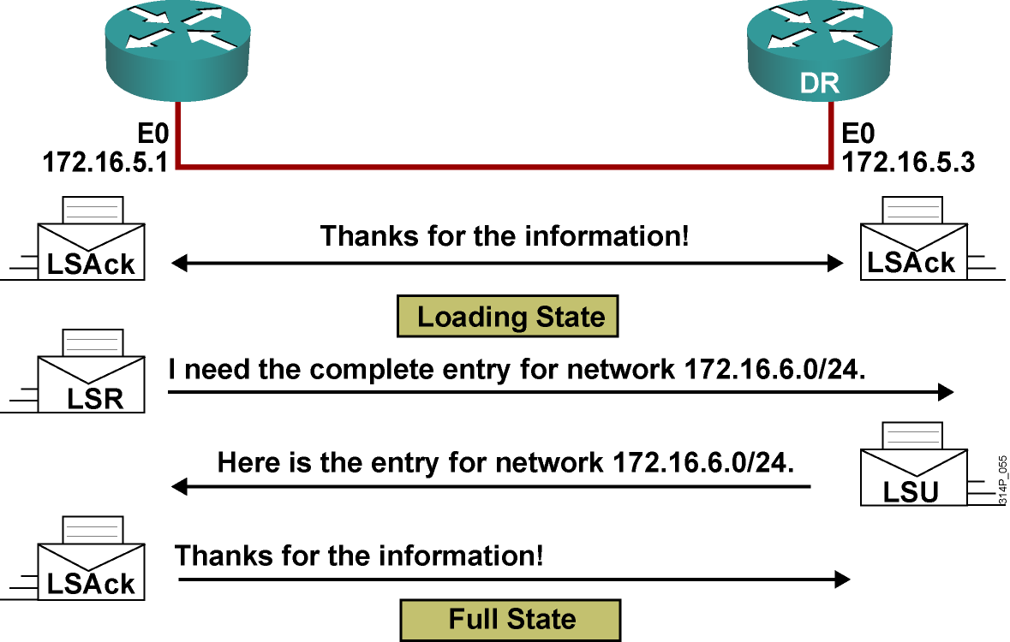
Adding the Link-State Entries

Slide 6
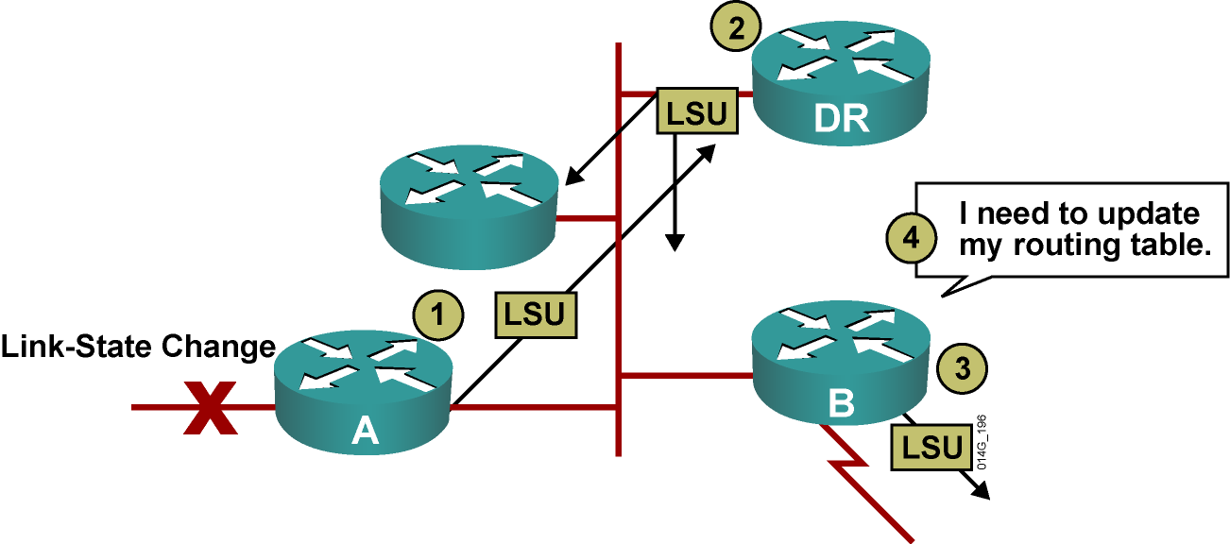
Maintaining Routing Information
  Router A notifies all OSPF DRs on 224.0.0.6.
  DR notifies others on 224.0.0.5.

Slide 7
debug ip ospf packet
Debug of a single packet
R1#debug ip ospf packet
OSPF packet debugging is on
R1#
*Feb 16 11:03:51.206: OSPF: rcv. v:2 t:1 l:48 rid:10.0.0.12
aid:0.0.0.1 chk:D882 aut:0 auk: from Serial0/0/0.2
Shows fields in OSPF header

Slide 8
Configuring OSPF
OSPF Network Types

Slide 9
OSPF Network Types
The three types of networks defined by OSPF are:
  Point-to-point: A network that joins a single pair of routers.
  Broadcast: A multiaccess broadcast network, such as Ethernet.
  Nonbroadcast multiaccess (also called NBMA): A network that interconnects more than two routers but that has no broadcast capability. Frame Relay, ATM, and X.25 are examples of NBMA networks.
    Five modes of OSPF operation are available for NBMA networks.

Slide 10

Point-to-Point Links
  Usually a serial interface running either PPP or HDLC.
  May also be a point-to-point subinterface running Frame Relay or ATM.
  No DR or BDR election required.
  OSPF autodetects this interface type.
  OSPF packets are sent using multicast 224.0.0.5.

Slide 11
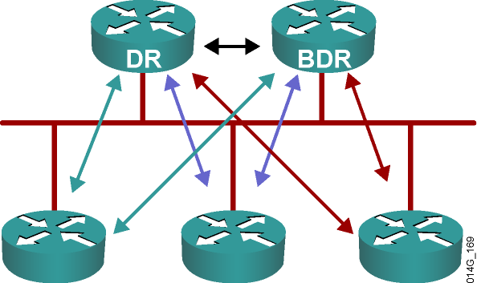
Multiaccess Broadcast Network
  Generally these are, LAN technologies like Ethernet and Token Ring.
  DR and BDR selection are required.
  All neighbor routers form full adjacencies with the DR and BDR only.
  Packets to the DR and the BDR use 224.0.0.6.
  Packets from DR to all other routers use 224.0.0.5.

Slide 12
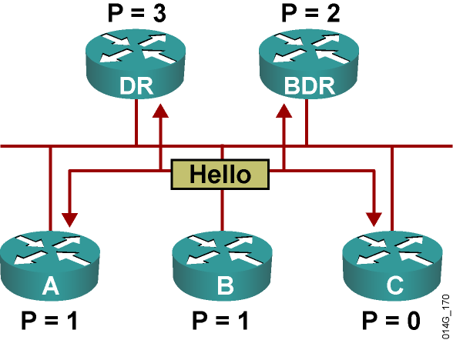
Electing the DR and BDR
  Hello packets are exchanged via IP multicast.
  The router with the highest OSPF priority is selected as
  the DR. The router with the second-highest priority value is the BDR.
  Use the OSPF router ID as the tiebreaker.
  The DR election is nonpreemptive.

Slide 13
Setting Priority for DR Election
Router(config-if)#ip ospf priority number
  This interface configuration command assigns the OSPF priority to an interface.
  Different interfaces on a router may be assigned different values.
  The default priority is 1. The range is from 0 to 255.
  0 means the router cannot be the DR or BDR.
  A router that is not the DR or BDR is DROTHER.

Slide 14
Creation of Adjacencies for Point-to-Point Mode
RouterA# debug ip ospf adj
OSPF: Interface Serial0/0/0.1 going Up
OSPF: Build router LSA for area 0, router ID 192.168.1.1, seq 0x80000023
OSPF: Rcv DBD from 192.168.1.2 on Serial0/0/0.1 seq 0xCF0 opt 0x52 flag 0x7 len 32 mtu 1500 state INIT
OSPF: 2 Way Communication to 192.168.1.2 on Serial0/0/0.1, state 2WAY
OSPF: Send DBD to 192.168.1.2 on Serial0/0/0.1 seq 0xF4D opt 0x52 flag 0x7 len 32
OSPF: NBR Negotiation Done. We are the SLAVE
OSPF: Send DBD to 192.168.1.2 on Serial0/0/0.1 seq 0xCF0 opt 0x52 flag 0x2 len 132
OSPF: Rcv DBD from 192.168.1.2 on Serial0/0/0.1 seq 0xCF1 opt 0x52 flag 0x3 len 132 mtu 1500 state EXCHANGE
OSPF: Send DBD to 192.168.1.2 on Serial0/0/0.1 seq 0xCF1 opt 0x52 flag 0x0 len 32
OSPF: Database request to 192.168.1.2
OSPF: sent LS REQ packet to 192.168.1.2, length 12
OSPF: Rcv DBD from 192.168.1.2 on Serial0/0/0.1 seq 0xCF2 opt 0x52 flag 0x1 len 32 mtu 1500 state EXCHANGE
OSPF: Exchange Done with 192.168.1.2 on Serial0/0/0.1
OSPF: Send DBD to 192.168.1.2 on Serial0/0/0.1 seq 0xCF2 opt 0x52 flag 0x0 len 32
OSPF: Synchronized with 192.168.1.2 on Serial0/0/0.1, state FULL
%OSPF-5-ADJCHG: Process 100, Nbr 192.168.1.2 on Serial0/0/0.1 from LOADING to FULL, Loading Done
OSPF: Build router LSA for area 0, router ID 192.168.1.1, seq 0x80000024

Slide 15
Creation of Adjacencies for Broadcast Mode
RouterA# debug ip ospf adj
OSPF: Interface FastEthernet0/0 going Up
OSPF: Build router LSA for area 0, router ID 192.168.1.1,seq 0x80000008
OSPF: 2 Way Communication to 172.16.1.1 on FastEthernet0/0, state 2WAY
OSPF: end of Wait on interface FastEthernet0/0
<output omitted>
OSPF: Neighbor change Event on interface FastEthernet0/0
OSPF: DR/BDR election on FastEthernet0/0
OSPF: Elect BDR 172.16.1.1
OSPF: Elect DR 192.168.1.1
DR: 192.168.1.1 (Id) BDR: 172.16.1.1 (Id)
OSPF: Rcv DBD from 172.16.1.1 on FastEthernet0/0 seq 0x14B 7 opt 0x52 flag 0x7 len 32 mtu 1500 state EXSTART
OSPF: First DBD and we are not SLAVE-if)#
OSPF: Send DBD to 172.16.1.1 on FastEthernet0/0 seq 0xDCE opt 0x52 flag 0x7 len 32
OSPF: Retransmitting DBD to 172.16.1.1 on FastEthernet0/0[1]
OSPF: Rcv DBD from 172.16.1.1 on FastEthernet0/0 seq 0xDCE
opt 0x52 flag 0x2 len 152 mtu 1500 state EXSTART
<output omitted>

Slide 16
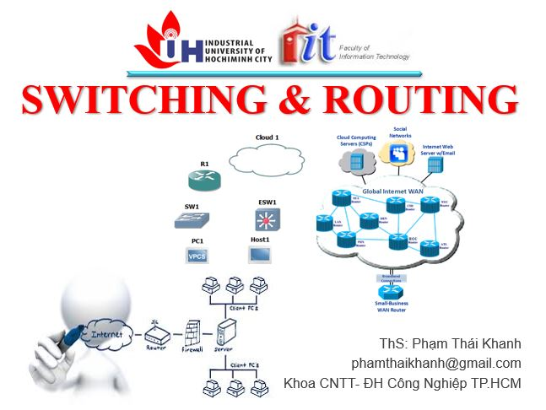


phamthaikhanh@gmail.com
This Photo by Unknown Author is licensed under CC BY-NC

